Slide 1


Slide 2



In-the-moment help for in-the-moment stress.
November 7, 2021
This Photo by Unknown author is licensed under CC BY.

Slide 3

… that time I almost quit.
About two years ago in the ICU, I had a patient who was having a massive bleed from his stomach. Every blood cell we gave him through his IV ended up on the floor. For 12 hours, I stepped over and through blood and navigated around code carts to give him the best care I could. As we prepared to intubate him, he asked me,
“Please don’t let me die.”
With every ounce of blood that dripped onto the floor, I felt myself drowning. The 5-minute increments of my relief that my co-workers gave me were spent staring blankly and standing frozen. My patient lived, but I couldn’t be sure that I was going to return to work - that night or ever.

Slide 4

Problem Articulation
Bedside nurses are experiencing trauma in the workplace without support in the moment, at the point of distress.
The Stats
Nurses have significant increases in anxiety (43%) and depression (26%).
In the 2021 McKinsey survey, 22% of nurses indicated they may leave their direct patient care role within a year.
AACN surveyed 6,000 critical care nurses & 66% have considered leaving their jobs due to the pandemic. If they leave - it will cost $349 million to replace them.

Slide 5
Are there any current solutions?
After the shift, Burnalong, Calm and the Insight Timer can provide relief for the nurse.
Employee survey (i.e., SurveyMonkey & Qualtrics) products can provide feedback for the hospital.
None of these solutions combine immediate relief to nurses and the provision of real-time data of nursing distress to hospitals.

Slide 6

Our Solution
Nurses text Realtime Nurse Support anonymously and rate their distress in the workplace according to a stop-light chart.
Red is severe distress – do a box breath or direct nurse to contact nurse supervisor.
Yellow is moderate distress – inspirational quote or prompts to release stress in the body. "Unclench your jaw."
Green is minimal to no distress – encouraging quotes.
AI based and would require further development of algorithms.

Slide 7
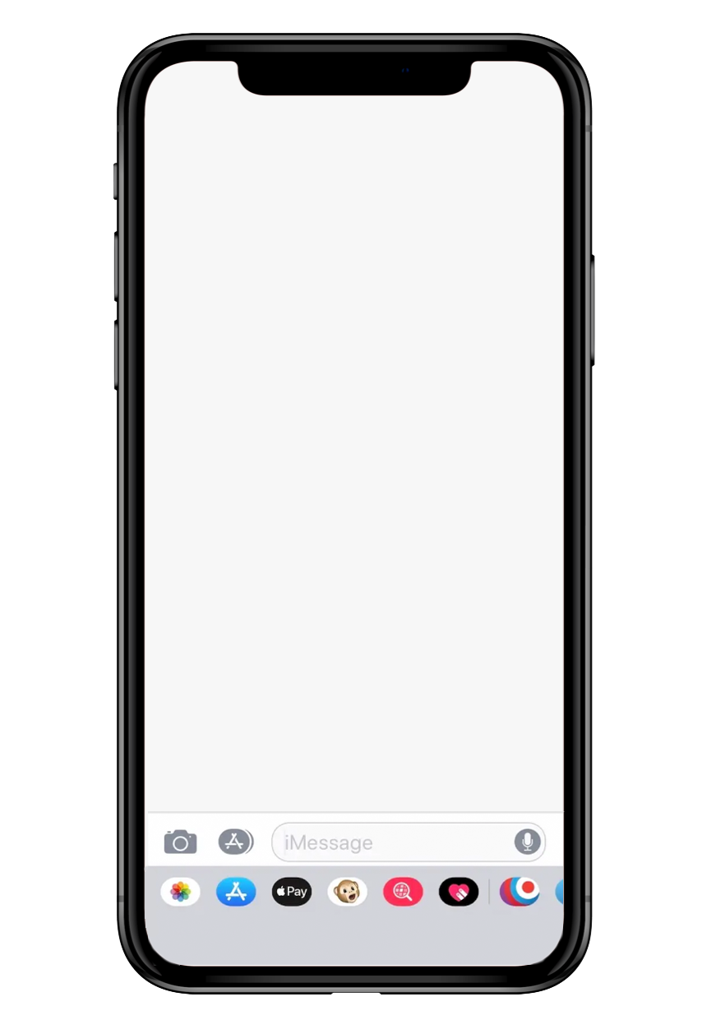
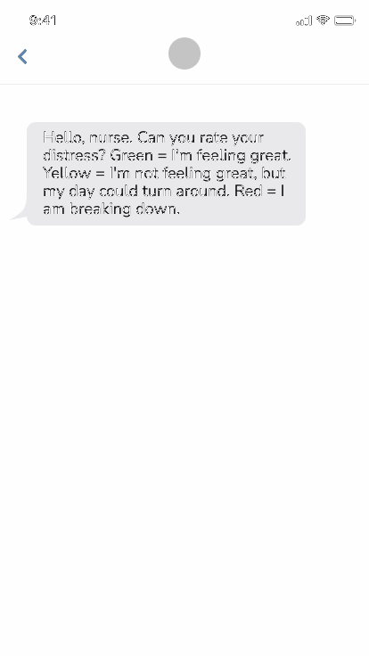
For Nurses
Real time support – they send a text and get a response with an immediate action they can take.

Slide 8
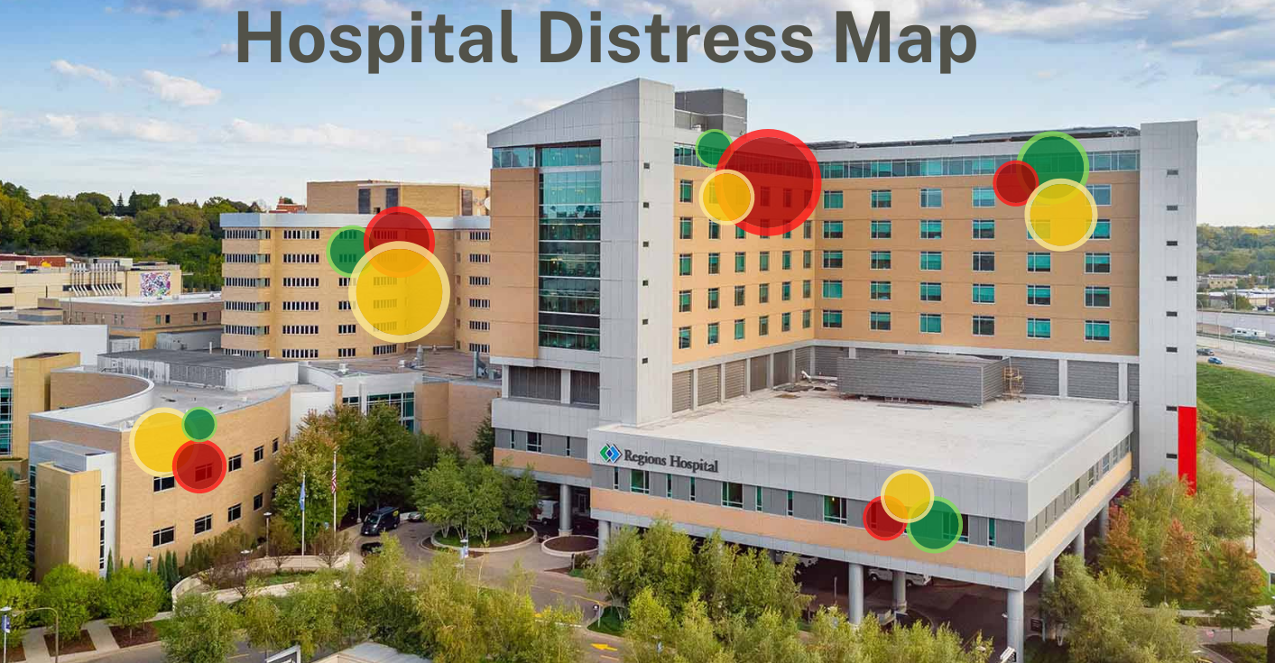
For Hospitals
Actionable metrics, down to the unit level & the opportunity to intervene in the moment when there are high levels of distress.
Tracking trends over time

Slide 9
Implementation Costs
The hospital pays for a subscription to this text-based service to visualize stress hotspots real-time within the nursing staff.
The development of a text-based service through a service such as Salesforce would be relatively inexpensive. Further research would be required to determine the financial specifics.

Slide 10
Scalability
This tool could grow to assess distress of nurses by department, with free-text responses re: factors contributing to stress during the shift.
That data could be aggregated and sorted into different categories by an algorithm and presented to their hospital as a report of factors that contribute to distress for nurses on a weekly, monthly or quarterly basis.

Slide 11

In Closing
Two years ago, I could have used the reminder that I was doing a good job. A reminder to breathe. The evidence is showing us that nurses in the US could use the same thing, now.
We can give bedside nurses a tool to combat their ever-increasing anxiety at work and give organizations the data they need to keep nurses at the bedside.

Slide 12



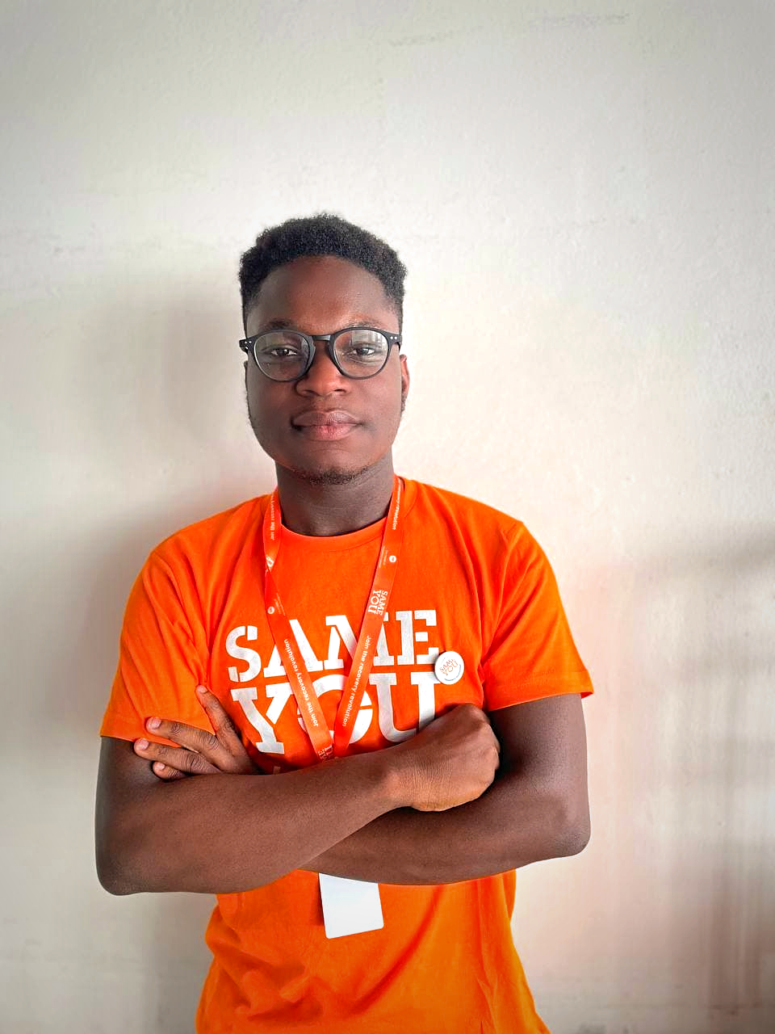
Bellinda Accimé, BSN RN CCRN is a critical care nurse from Philadelphia, PA with over 10 years of bedside nursing experience in other specialties, like psychiatric nursing and palliative care. Bellinda is currently a Master's degree student at the University of Pennsylvania in the Psychiatric Mental-Health Nurse Practitioner track. baccime@upenn.edu | Darreis Lucien, MN, RN, PHN, DNP (c) Nurse Educator, Associate Degree Nursing Program, Sacramento City College. Co-Director, The Medical Team, INC. Mission work in Africa and Mexico. | Karen Steinbock, MBA, BSN, RN has served as an ER nurse in the military, Director of Nursing for a primary care system, and provides 1:1 coaching for nurses. Karen sees similarities between her experiences as a Navy Nurse in Iraq and the trauma being experienced by front line nurses in the battle against COVID-19, and she is a strong advocate for mental health care and for increasing self-awareness/early interventions for nurses. | Stephanopoulos Osei BSN is a newly grad nurse from Accra, Ghana. Stephan is currently preparing to enter the nursing workforce and also working on a nurse-led teleneurorehabilation service for stroke patients in Accra.

Slide 13
How Does This Help the Hospital?
Lock high distress units so they would be closed/on divert to additional admissions.
Once they attain and maintain a majority “green” status for a period, advertise this metric to attract new nursing talent.
Predict high stress shifts for nurses, according to unit and try to prevent a distressing night from occurring.
Call around for extra support & send staff to units in distress.
Send a supervisor or management to assess the acuity on the floor firsthand.

Slide 14
Why Would Nurses Use This?
A text-based service doesn't need wi-fi or smartphone – increases access for staff who may not have smartphones and more consistently accessible inside hospital spaces.
They would want to ensure that their voices continue to be heard by their organizations.
Nurses need the in-the-moment relief when they are too distressed to help themselves.

